Slide 1

Prepared by Group 3
Group Project
Work and Stress
06 February 2025

Slide 2




Team Members
Chris Dobbin
Ellen Liu
Pratishtha Theeng
Sarah Burnap
Jordan Dreyer
Member
Member
Member
Member
Member

Slide 3
Introduction
Work-related stress is physical and emotional strain experienced by individuals due to pressures and challenges in the workplace, such as heavy workloads, tight deadlines, job insecurity, and lack of support, which can negatively impact their health and job performance.

Slide 4

Analysis Objectives
Exploring the impact of Work-related Stress
Investigating how stress in the workplace affects employees` well-being, productivity, and overall job satisfaction
Understanding the Sources of Work Stress
Analyzing key stressors, such as workload, company size, and work-life balance, and their correlation with performance and mental health

Slide 5

Key Factors Influencing Corporate Workplace Stress
Point I
Lorem……..
Point III:
lorem
Point II
lorem

Slide 6
Exploring Gender Biasness
50.70% of Non-binary experiences gender biasness at workplace
50% of Female experiences gender biasness at workplace
50.40% of Male experiences gender biasness at workplace

Slide 7
Gender VS Stress Analysis
Stress Level were categorized into three different type based on the rating:
Lowest : 0 - 4
Moderate : 5 - 7
Highest : 8 -10

Slide 8
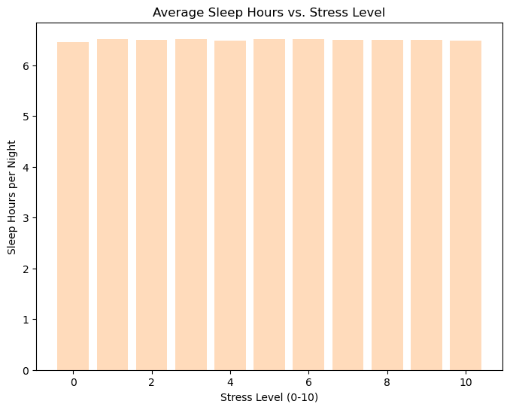
Average Sleep and Stress
How does sleep affect stress levels at work?
Our initial though was that less sleep would raise stress levels.
Surprisingly, the bars are almost the same height, which isn’t what we’d expect in real-world data.
This consistency leads us to the data missing natural variations.
To make sure the data is reliable, we’d need to check how it was collected to capture real differences in sleep patterns.

Slide 9
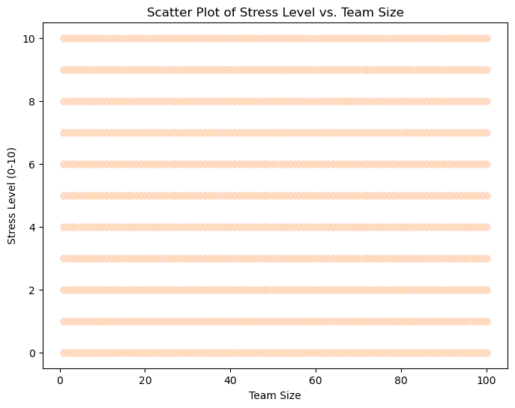
Impact of team size in Workplace stress
Does team size really impact
stress levels?
The scatter plot shows stress levels aligning in horizontal bands, suggesting little to no variation.
In real-world data, we’d expect more spread, as stress levels differ among individuals.
Uniformity of the data reveals inconsistency Reviewing the data collection process might help clarify.

Slide 10
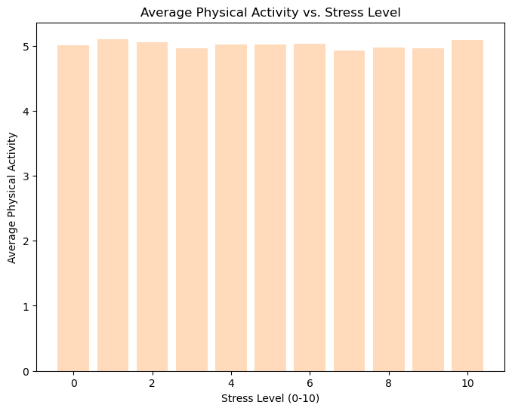
Correlation between physical activity and stress
Does the Gym help with
workplace stress?
The chart shows average physical activity across different stress levels, but there is no measurable variance without stretching the numbers
This lack of fluctuation suggests that stress levels have no discernible impact on physical activity in this dataset, which is unusual.
The uniformity strongly indicates that the data may be artificially smoothed rather than naturally observed.

Slide 11
Work Model contribution to stress
Stress Level were categorized into three different type based on the rating:
Lowest : 0 - 4
Medium : 5 - 7
Highest : 8 -10

Slide 12
Conclusion
CONCLUSION

Slide 13
Thank you

